Slide 1
A somewhat gentle introduction to
Jason W. Eckert

Slide 2
The what and why
Relatively new VPN technology (i.e. not as mature as OpenVPN)
  Cross platform: Linux, BSD, Windows, Android, iOS, macOS
  Implemented in kernel space on Linux
High performance & strong crypto
  ChaCha20 & Curve25519
  Built-in protection for impersonation & crypto attacks
Simple structure
  No built-in authentication overhead (↓ bloat, ↑ flexibility)
  Functions only when traffic is sent (↓ bandwidth)

Slide 3
Other stuff
You can get it from your Linux/BSD software repo or via an app
  Details @ https://www.wireguard.com/install/
  Avoid the macOS app right now and install via Homebrew or MacPorts
  I’m using Fedora, so I’ll use sudo dnf install wireguard-tools
Approach:
  To start we’ll implement WireGuard from scratch between 2 Linux systems
  Next, we’ll make a persistent WireGuard configuration
  Finally we’ll apply this to other use cases

Slide 4
Basic VPN implementation (2 peers)
No server or client (but easier to visualize)
Virtual Private Network (VPN) = overlay network that auto-encrypts traffic
We’ll keep to IPv4 for simplicity (although IPv6 works too)

Slide 5
  Generate asymmetric public/private key pair on each peer:
  [root@server ~]# wg genkey | tee privatekey | wg pubkey > publickey
  [root@server ~]# cat privatekey +FqYdSx+rIg2gwwyd3hCfap/1Vz3z2UuRZCPKKwMaXw=
  [root@server ~]# cat publickey
  cjmyZf4c+6U3pD2QT+6Bxkjj9qzU8EePjc8dSeuXvWs=
  [root@client ~]# wg genkey | tee privatekey | wg pubkey > publickey
  [root@client ~]# cat privatekey 0EQpGsSfGwVRdxcCywG2ymnLG7mjmv+rB02UodcH10k=
  [root@client ~]# cat publickey 8pfWwwPK8R+Qe/fuN5FZ0P2ddngWd8s79sOQw5Q7SXE=

Slide 6
  Construct a WireGuard interface on each peer (virtual IP & port of your choice). The first interface is called wg0, and should use the private key you generated (public key is auto generated from private key):
  [root@server ~]# ip link add wg0 type wireguard
  [root@server ~]# ip addr add 172.16.0.99/24 dev wg0
  [root@server ~]# wg set wg0 private-key ./privatekey listen-port 55234
  [root@server ~]# ip link set wg0 up
  [root@server ~]# wg
  interface: wg0
  public key: cjmyZf4c+6U3pD2QT+6Bxkjj9qzU8EePjc8dSeuXvWs=
  private key: (hidden)
  listening port: 55234

Slide 7
  [root@client ~]# ip link add wg0 type wireguard
  [root@client ~]# ip addr add 172.16.0.1/24 dev wg0
  [root@client ~]# wg set wg0 private-key ./privatekey listen-port 55123
  [root@client ~]# ip link set wg0 up
  [root@client ~]# wg
  interface: wg0
  public key: 8pfWwwPK8R+Qe/fuN5FZ0P2ddngWd8s79sOQw5Q7SXE=
  private key: (hidden)
  listening port: 55123

Slide 8
  Add the client’s public key, IP & port to the server, as well as add the server’s public key, IP & port to the client. You must also specify the IP addresses or networks you will allow over WireGuard:
  [root@server ~]# wg set wg0 peer 8pfWwwPK8R+Qe/fuN5FZ0P2ddngWd8s79sOQw5Q7SXE= \
  allowed-ips 172.16.0.0/16 endpoint 192.168.1.107:55123
  [root@client ~]# wg set wg0 peer cjmyZf4c+6U3pD2QT+6Bxkjj9qzU8EePjc8dSeuXvWs= \
  allowed-ips 172.16.0.0/16 endpoint 192.168.1.106:55234
    When sending data to a peer, 172.16.0.0/16
    is treated like a target route.
    When receiving data from a peer, 172.16.0.0/16
    is treated like an access control list.

Slide 9
  [root@client ~]# ping 172.16.0.99
  <output omitted>
  [root@client ~]# wg
  interface: wg0
  public key: 8pfWwwPK8R+Qe/fuN5FZ0P2ddngWd8s79sOQw5Q7SXE=
  private key: (hidden)
  listening port: 55123
  peer: cjmyZf4c+6U3pD2QT+6Bxkjj9qzU8EePjc8dSeuXvWs=
  endpoint: 192.168.1.106:55234
  allowed ips: 172.16.0.0/16
  latest handshake: 18 seconds ago
  transfer: 8.21 KiB received, 15.10 KiB sent

Slide 10
  [root@server ~]# wg
  interface: wg0
  public key: cjmyZf4c+6U3pD2QT+6Bxkjj9qzU8EePjc8dSeuXvWs=
  private key: (hidden)
  listening port: 55192
  peer: 8pfWwwPK8R+Qe/fuN5FZ0P2ddngWd8s79sOQw5Q7SXE=
  endpoint: 192.168.1.107:51423
  allowed ips: 172.16.0.0/16
  latest handshake: 27 seconds ago
  transfer: 7.01 KiB received, 11.39 KiB sent

Slide 11
Making WireGuard configuration persistent
Method 1: Write a shell script:
  [root@client ~]# cat wireguard-client.sh
  #!/bin/bash
  ip link add wg0 type wireguard
  ip addr add 172.16.0.1/16 dev wg0
  wg set wg0 private-key ./privatekey listen-port 55123
  ip link set wg0 up
  wg set wg0 peer cjmyZf4c+6U3pD2QT+6Bxkjj9qzU8EePjc8dSeuXvWs= allowed-ips 172.16.0.0/16 endpoint 192.168.1.106:55234

Slide 12
Method 2: Use /etc/wireguard/wg0.conf:
  [root@client ~]# wg showconf wg0 > /etc/wireguard/wg0.conf
  [root@client ~]# chmod 600 /etc/wireguard/wg0.conf
  [root@client ~]# cat /etc/wireguard/wg0.conf
  [Interface]
  Address = 172.16.0.1/16
  ListenPort = 55123
  PrivateKey = 0EQpGsSfGwVRdxcCywG2ymnLG7mjmv+rB02UodcH10k=
  [Peer]
  PublicKey = cjmyZf4c+6U3pD2QT+6Bxkjj9qzU8EePjc8dSeuXvWs=
  AllowedIPs = 172.16.0.0/16
  Endpoint = 192.168.1.106:55234
  [root@client ~]# wg-quick up wg0
  [root@client ~]# systemctl enable wg-quick@wg0.service

Slide 13
Using WireGuard to access a remote network

Slide 14
Method 1: WireGuard server behind a NGFW

Slide 15
  [root@client ~]# cat /etc/wireguard/wg0.conf
  [Interface]
  PrivateKey = 0EQpGsSfGwVRdxcCywG2ymnLG7mjmv+rB02UodcH10k=
  Address = 172.16.0.1/16
  DNS = 1.1.1.1 #By specifying DNS here, name resolution is faster
  #No ListenPort needed!
  [Peer]
  PublicKey = cjmyZf4c+6U3pD2QT+6Bxkjj9qzU8EePjc8dSeuXvWs=
  AllowedIPs = 0.0.0.0/0 #This forwards all traffic to the WireGuard server
  Endpoint = publicIP:55234

Slide 16
  [root@server ~]# sysctl -w net.ipv4.ip_forward=1 >> /etc/sysctl.conf
  [root@server ~]# cat /etc/wireguard/wg0.conf
  [Interface]
  PrivateKey = +FqYdSx+rIg2gwwyd3hCfap/1Vz3z2UuRZCPKKwMaXw=
  Address = 172.16.0.99/16
  ListenPort = 55234
  PostUp = iptables -A FORWARD -i wg0 -j ACCEPT; iptables -t nat -A POSTROUTING \
  -o eth0 -j MASQUERADE
  PostDown = iptables -D FORWARD -i wg0 -j ACCEPT; iptables -t nat -D POSTROUTING \
  -o eth0 -j MASQUERADE
  [Peer]
  PublicKey = 8pfWwwPK8R+Qe/fuN5FZ0P2ddngWd8s79sOQw5Q7SXE=
  AllowedIPs = 172.16.0.0/16
  #No Endpoint needed!

Slide 17
Method 2: WireGuard server connected to the demarc

Slide 18
  Nearly all the configuration is identical, except:
    The client specifies the endpoint of the actual WireGuard server connected to the demarc (no need for port forwarding or reverse proxy on NGFW)
    You must specify the network interface that is connected to the DMZ when configuring IP masquerading on the server. If this network is eth1 (since eth0 is connected to the demarc), then:
  [root@server ~]# grep Post /etc/wireguard/wg0.conf
  PostUp = iptables -A FORWARD -i wg0 -j ACCEPT; iptables -t nat -A POSTROUTING \
  -o eth1 -j MASQUERADE
  PostDown = iptables -D FORWARD -i wg0 -j ACCEPT; iptables -t nat -D POSTROUTING \
  -o eth1 -j MASQUERADE

Slide 19
Using WireGuard to secure traffic between
2+ networks

Slide 20
  [root@server1 ~]# cat /etc/wireguard/wg0.conf
  [Interface]
  PrivateKey = 0EQpGsSfGwVRdxcCywG2ymnLG7mjmv+rB02UodcH10k=
  Address = 172.16.1.99/16
  ListenPort = 55123
  PostUp = iptables -A FORWARD -i wg0 -j ACCEPT; iptables -t nat -A POSTROUTING \
  -o eth1 -j MASQUERADE
  PostDown = iptables -D FORWARD -i wg0 -j ACCEPT; iptables -t nat -D POSTROUTING \
  -o eth1 -j MASQUERADE
  [Peer]
  PublicKey = cjmyZf4c+6U3pD2QT+6Bxkjj9qzU8EePjc8dSeuXvWs=
  AllowedIPs = 10.2.0.0/16 #Forwards traffic for 10.2.x.0/24 networks to server2
  Endpoint = server2publicIP:55234

Slide 21
  [root@server2 ~]# cat /etc/wireguard/wg0.conf
  [Interface]
  PrivateKey = +FqYdSx+rIg2gwwyd3hCfap/1Vz3z2UuRZCPKKwMaXw=
  Address = 172.16.2.99/16
  ListenPort = 55234
  PostUp = iptables -A FORWARD -i wg0 -j ACCEPT; iptables -t nat -A POSTROUTING \
  -o eth1 -j MASQUERADE
  PostDown = iptables -D FORWARD -i wg0 -j ACCEPT; iptables -t nat -D POSTROUTING \
  -o eth1 -j MASQUERADE
  [Peer]
  PublicKey = 8pfWwwPK8R+Qe/fuN5FZ0P2ddngWd8s79sOQw5Q7SXE=
  AllowedIPs = 10.1.0.0/16 #Forwards traffic for 10.1.x.0/24 networks to server1
  Endpoint = server1publicIP:55123

Slide 22
One more thing…
  Some NGFWs and NAT routers don’t like that WireGuard only sends traffic when it needs to. To make WireGuard a bit more “chatty”, add the following to your configuration:
  [root@client ~]# grep –i keep /etc/wireguard/wg0.conf
  KEEPALIVE_PERIOD = 25
  Easy masquerading & client isolation:
  [root@server ~]# egrep –i "(internet|client)" /etc/wireguard/wg0.conf
  ALLOW_INTERNET_ACCESS = yes
  CLIENT_TO_CLIENT = no
  You can also get this presentation in blog format @ jasoneckert.net

Slide 23
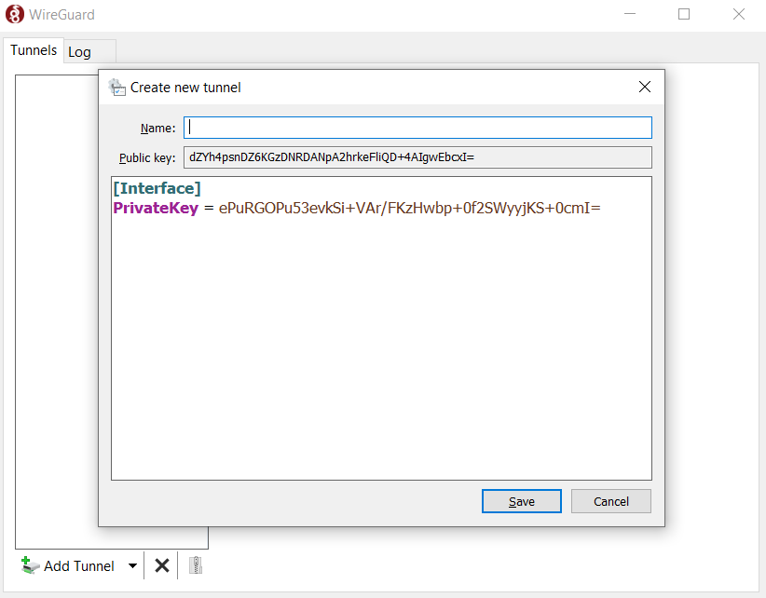
Using the apps

