Slide 1
Security & Privacy
… and why you should care.
Sarah Harvey
{CrySP, Information Retrieval} group
University of Waterloo
sharvey@cs.uwaterloo.ca

Slide 2
Why this talk?

Slide 3
Why this talk?
Lots of media coverage on Snowden, NSA, and other government agencies
Media coverage on sec/privacy policies companies
Does the general public actually understand what all of this means?
What are the implications of these findings?
Not just technological, but social context

Slide 4
Who am I?
…mostly just some PhD student at UW
Interested in Sec/Pri problems in IR systems
User profiling, user behavior
Privacy implications of profiling, linking
Improving privacy of large IR systems
Interested promoting awareness of security, privacy systems

Slide 5
Outline
Motivation
What defines security? privacy?
Who gets to see your stuff?
Who is the “bad guy”?
Snowden and friends
The issue of trust

Slide 6
This, Jen… is the internet

Slide 7
What is the internet?
Network of networks
Internet
Cloud

Slide 8
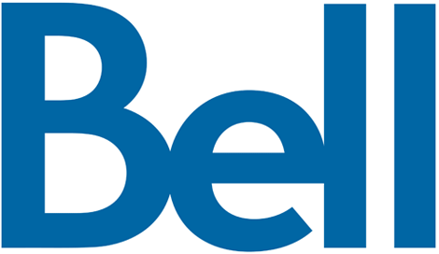
A typical internet pathway
DNS
User
Internet
Server

Slide 9
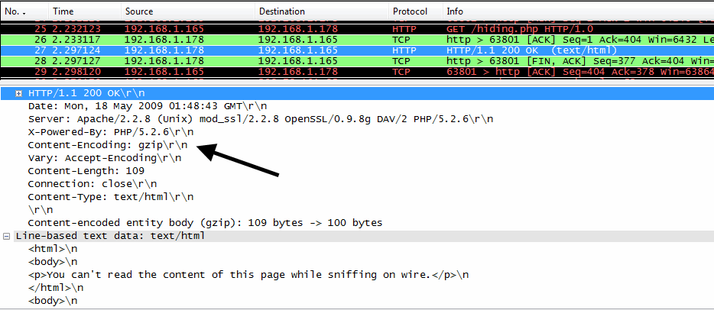
What’s on the wire?
Any of those people can see my stuff

Slide 10
Cryptography in 30 seconds
So we have this wonderful technology called cryptography.
Encryption protects confidentiality.
MACs/digital signatures protect integrity and authenticity.
Types of cryptographic systems:
Symmetric-key systems
Public-key systems

Slide 11
Applying crypto
Revisiting communication securely
DNS
User
Internet
Server

Slide 12
Revisiting the wire

Slide 13
Crypto in practice
HTTPS (the green padlock in your browser)
HTTP with SSL
Doesn’t hide endpoints
SSH (host keys, transport, pub/pri keys)
Doesn’t hide endpoints
Mail (STARTTLS, PGP/GPG)
PGP/GPG doesn’t protect mail headers

Slide 14
So…
We’re transmitting our data securely, but that doesn’t mean our communication is necessarily private.
Metadata is still being leaked:
Who we’re talking to
When
What method (e.g. thing ports/protocol)

Slide 15
Definitions in 30 seconds
Security is the practice of defending information from unauthorized parties
Prevent use, tampering, duplication, destruction
Privacy is the ability to seclude one’s information from unauthorized parties

Slide 16
Is this really of concern?
The communication itself is protected.
Is the metadata really that useful?
Is it possible to record all that information?

Slide 17
A different view
Let’s take a look at what other things we may inadvertently reveal:
Search/click habits (tied to a Google/Bing account)
Purchase habits (tied to a credit card, account)
Location habits (GPS, PRESTO card, etc.)
Etc.
We are living in an age where any and all information is collected about us.

Slide 18
Do we need to be concerned?
It depends on who the bad guy is.
In security/privacy circles, we have a notion of identifying who/what is our adversary.
We then make certain security assurances about what we can secure/hide against the defined adversary.

Slide 19
Recall how we’re usually told to secure our systems:
Don’t go to the super sketchy websites
Use antivirus
Use firewall
Don’t reuse passwords
Never put out personal information about yourself
We’re totally cool here, right guys?

Slide 20
Consider who the adversary is
Case 1: scriptkiddies and co.
Target: home machines/routers
Purpose: Pwn ur PC (for fun and profit)
Purpose: create botnets, zombie PCs, etc.
Method: various scripts/packages readily available (e.g. Metasploit)

Slide 21
Consider who the adversary is
Case 2: identity thieves
Target: accounts of specific users
Purpose: look for personal information for financial gain
Method: OSInt, specific backdoors, phishing

Slide 22
Consider who the adversary is
Case 3: government agencies
Target: whistleblowers (the physical person)
Purpose: prevent highly classified/sensitive information from being revealed
Method: <CLASSIFIED>

Slide 23
Consider who the adversary is
Case 4: corporations
Target: everyone
Purpose: improve services for all users; research
Method: marketing, lax policies, privacy guarantees
Method: scanning through consumed content

Slide 24
Why does this all matter?
We knowingly or unknowingly end up providing a large amount of information about ourselves
We now have systems that are capable of both storing and analyzing this data
(This is the focus of information retrieval systems)
We often trust major third parties to do the right thing in order to provide us with useful services

Slide 25
Speaking of third parties…

Slide 26
Snowden affair

Slide 27
Snowden affair
Leaked a number of documents suggesting government surveillance programs in place:
PRISM
XKeyscore
Tempora
Called the most significant leak in US history

Slide 28
Companies response:
Nope.
There is no way that Microsoft, Google, Facebook, Apple, etc. would willingly provide the NSA with information.
Policies exist to protect the user, right?

Slide 29
Haha no.

Slide 30
Haha no.

Slide 31
Clearly we can trust crypto

Slide 32
…or trust Linux

Slide 33
So why do we care?
We can’t just worry about protecting explicit information
Lots of implicit information being leaked
Our data is subject to… who’s whims?
Hackers?
Corporations?
Gov’t Agencies?
We may not be threats to national security, but we should be aware that this is happening, and be guaranteed some level of privacy

Slide 34
Two recent things to think about
Adobe leak:
Big company = millions of users
Source code compromised
Passwords were encrypted, not hashed
NSA v. The World:
German Chancellor Merkel’s phone was tapped
NSA reveals to be monitoring the links between users and corporate datacenters

Slide 35
SSL Added and Removed here!

Slide 36
Questions? Open Discussion
http://teespring.com/nsassl

