Slide 1
Demystifying Docker, Kubernetes, Rancher, Portainer, containerization, CI/CD pipeline, microservices, etc.

Slide 2
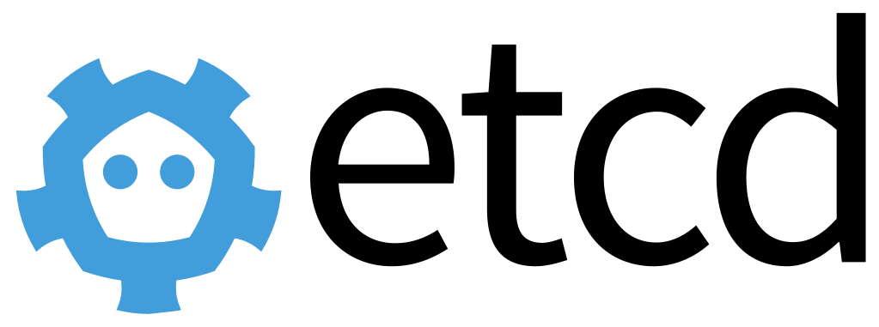
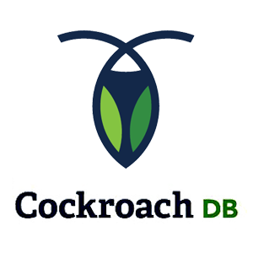
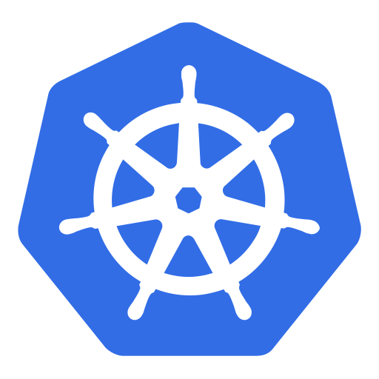
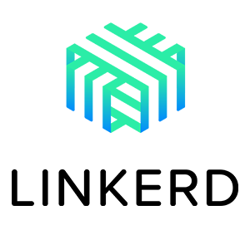
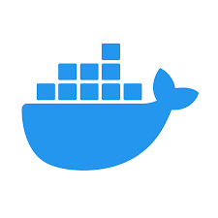
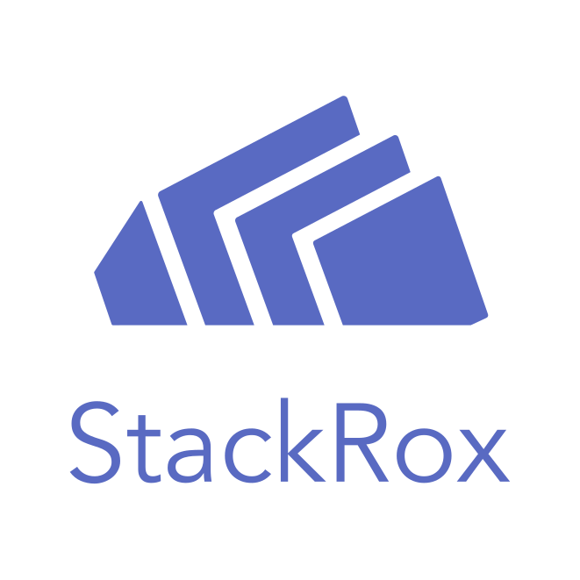
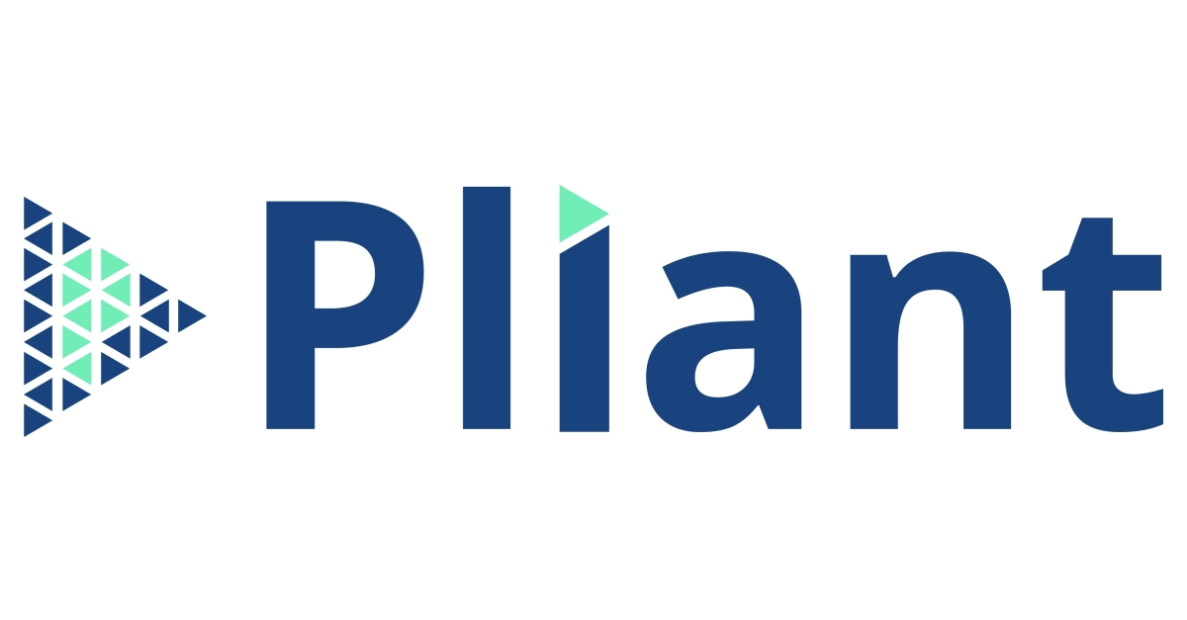
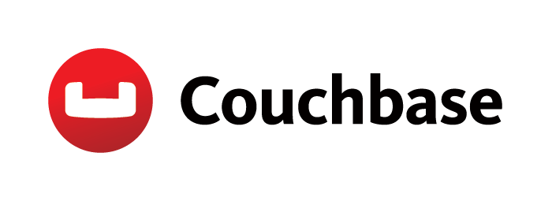

Slide 4
Original Topic Request:
Buzzwords: Docker, Kubernetes, Rancher, Portainer, containerization, CI/CD pipeline, microservices, etc.
Why should we care about these things?
How are they related to each other (if indeed they are related)?

Slide 5
Douglas Adams 3 rules of technology:
Anything that is in the world when you’re born is normal and ordinary and is just a natural part of the way the world works.
Anything that's invented between when you’re fifteen and thirty-five is new and exciting and revolutionary and you can probably get a career in it.
Anything invented after you're thirty-five is against the natural order of things.

Slide 6
Why I follow this stuff?
I’m a UNIX sysadmin & developer
The cloud native landscape feels natural & fun
UNIX philosophy → microservices
NIS & NFS → IaC & cloud
.cfg/.rc → .json/.yaml
Makefiles → Makefiles
UNIX → Linux (& BSD)

Slide 7
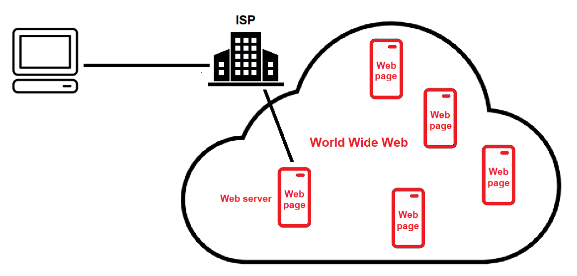

Slide 8
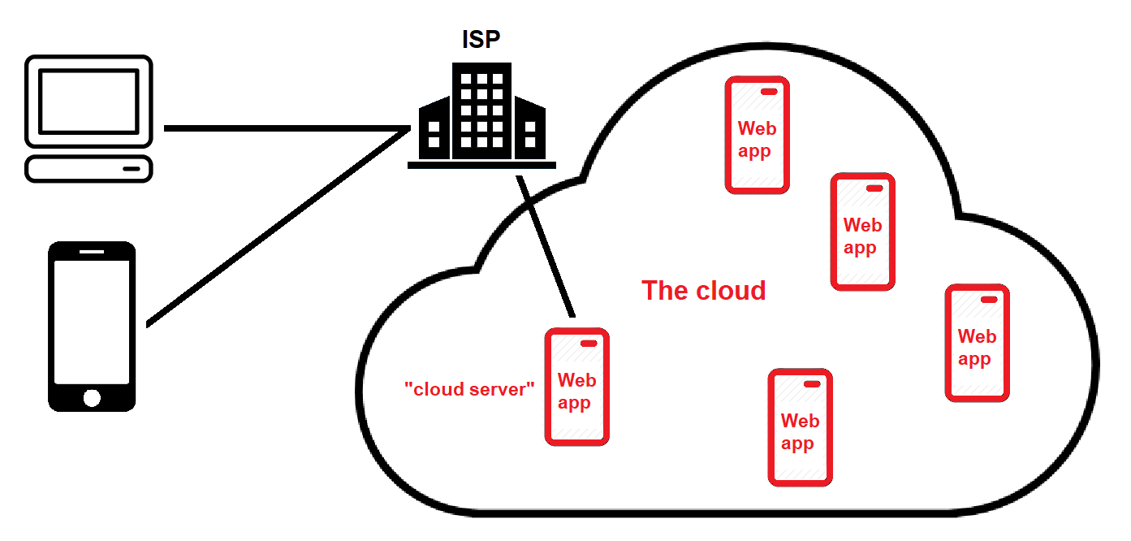

Slide 9
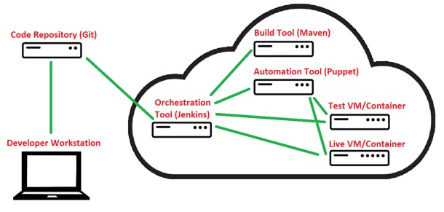

Slide 10
CD (orchestrate, automate, IaC, EIEIO, etc.)
CI

Slide 11
CD (orchestrate, automate, IaC, EIEIO, etc.)
CI
devop

Slide 12
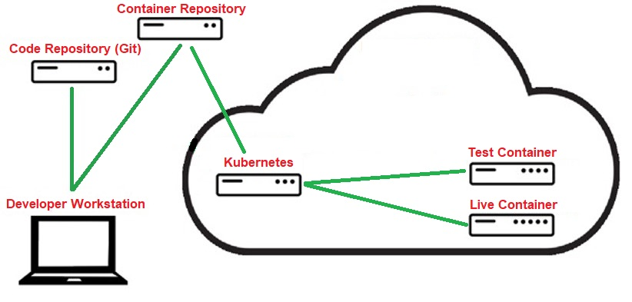
CD (orchestrate, automate, IaC, EIEIO, etc.)
CI
SRE
devop

Slide 13
CD (orchestrate, automate, IaC, EIEIO, etc.)
CI
SRE
devop
Gitops?
devsecops?

Slide 14
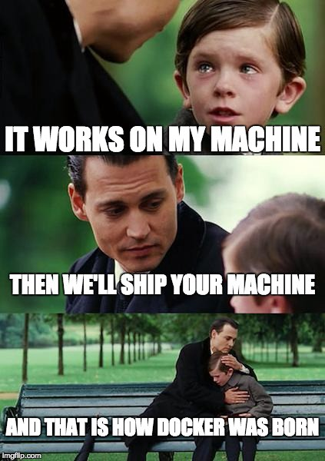

Slide 15
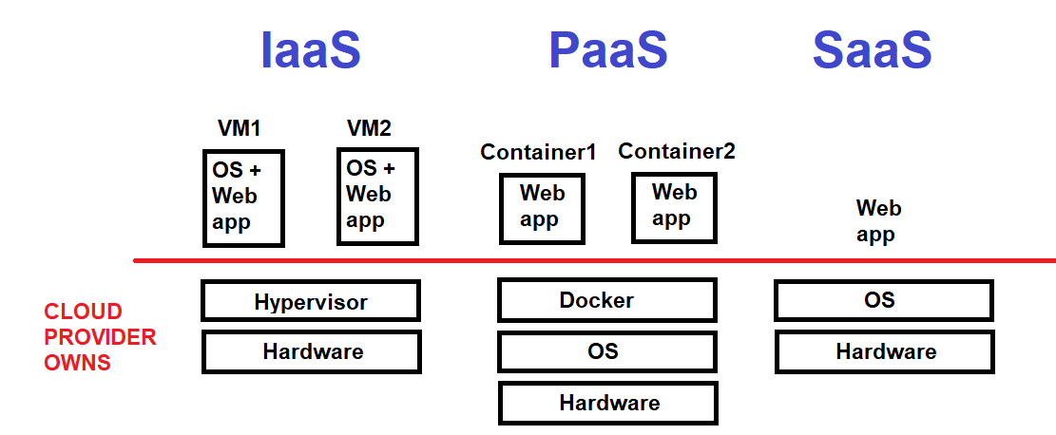

Slide 16
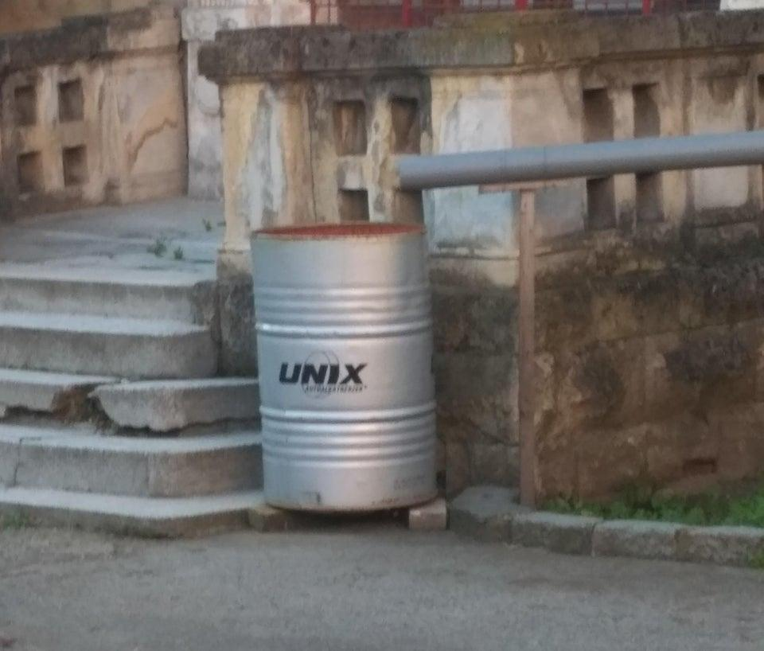

Slide 17
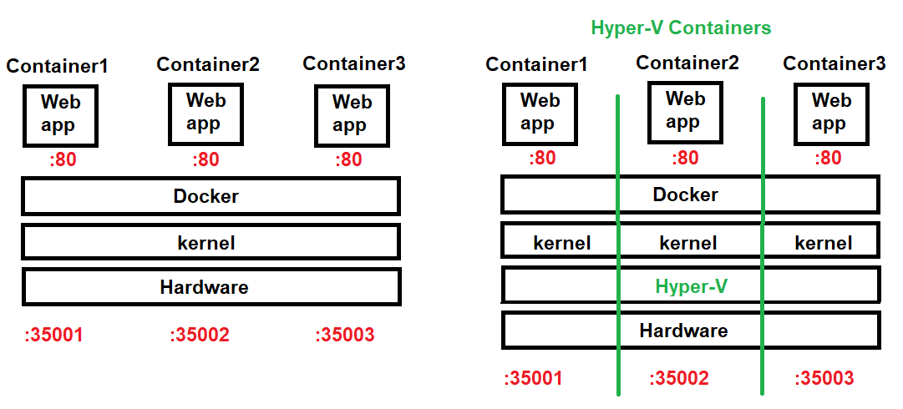

Slide 18
Containers and why are they good
OS virtualization (=BSD jails)
namespace (restrict what container sees using syscalls)
cgroups (limits resources container uses)
chroot (sets / to the container image) – also /proc
Liz Rice Containers from Scratch:
https://www.youtube.com/watch?v=8fi7uSYlOdc
Use underlying Linux kernel + container runtime
Except Hyper-V containers & LCOW which provide a separate kernel for each container

Slide 19
Containers and why are they good
Easier to develop/evolve microservices
UNIX philosophy at work
Containers can be combined to create larger services
Containers can be scaled (unevenly too)
Just makes sense (comp sci is all about containers nowadays)
Can be used to add virtualized apps to an existing on-prem system or cloud VM
Want to learn Docker?
Docker Desktop comes with great tutorial (macOS run a Linux VM, Windows uses WSL2)
Can also try: https://labs.play-with-docker.com/

Slide 20
Containers and why are they good
Container runtimes:
LXC (LXD is just LXC's REST tool) – sysadmins/proxmox
Docker = LXC + portable deployment (1 object with multiple containerized apps) + versioning + component/library reuse (index.docker.io)
Podman (daemonless Docker)
CRI-O (made for Kubernetes)
containerd (CRI-compliant)

Slide 21
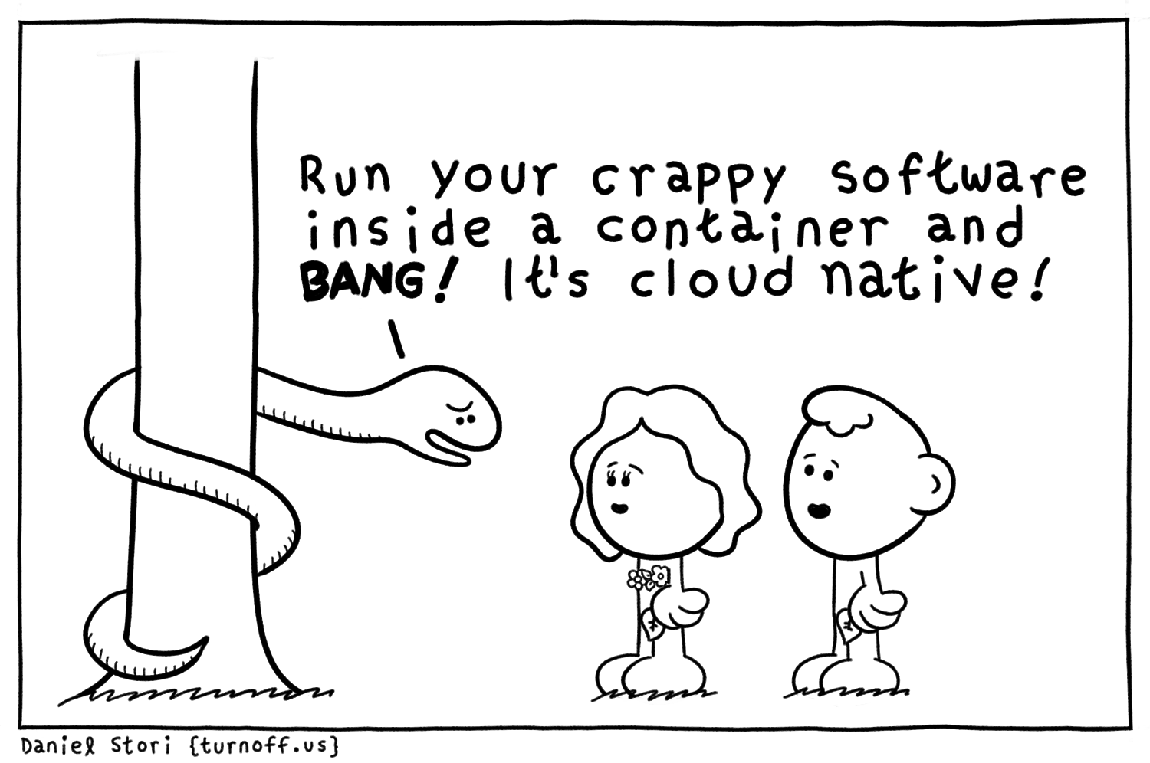
Containers and why are they good
Kubernetes natively supports CRI-O/containerd (Docker with a shim, but that is deprecated)
Developers typically use Docker, Podman to create OCI-compliant container images that work on any container runtime (cloud native)

Slide 22
When it comes to orchestrators

Slide 23
Kubernetes/K8S
Is NOT hard
You must put on your dev mindset at first
Microservice scaling is a developer-first thing!
K8S provides a common API for implementing containers and managing resources (pods, deployments, services, etc.)
Start small
Docker Desktop, minikube, kind, Rancher Desktop (k3s), microk8s
Sweat equity
Later, you must put on your sysadmin mindset
Networking, security, authentication, storage

Slide 24
Cloud Native: The Series
2011: Jenkins was king
Nothing was simple, and devops meant devops
2012: ???
2013: Docker is the new kid on the block
2014: New orchestrators
Rancher was the hot new startup (managed Docker containers)
Jenkins bought by Cloudbees and put on maintenance?
Docker Swarm & K8S

Slide 25
Cloud Native: The Series
2015: Things get formal
Docker starts Open Container Initiative (OCI) → containerd (OCI-compliant)
Cloud-native Computing Foundation (CNCF)
OpenShift gains traction after it adopts Docker & K8S
Microsoft announces Docker support in upcoming Server 2016/10 builds
2016: K8S ~ IBM PC of the cloud world

Slide 26
Cloud Native: The Series

Slide 27
Cloud Native: The Series
2017: K8S Gold rush
People start making management & reporting tools (e.g. Portainer)
The big PaaS providers got in on it (hyperscalers)
Docker gets much more attention
Big push towards promoting container/microservice-focused development (start of evangelism)

Slide 28
Cloud Native: The Series
2018: Everyone and their mother pivots to support K8S (Jenkins X, Rancher)
Shift to the other areas of cloud native landscape (security, auth, storage, DBs, etc.)
Docker gets freakin’ huge (and stable)
Dev evangelism supreme (Kelsey Hightower)
Role separation: SRE vs devops

Slide 29
Cloud Native: The Series
2019: pick your area(s)
Make K8S easier? Manage K8S clusters?
Do K8S differently? Rancher K3S (edge)
Security must be worth $$ (saturated quickly)
GitHub ecosystem started to mature (including workflow)
Tooling is really really good (developer-driven)
Docker monetization? Docker-EE sold to Mirantis.

Slide 30
Cloud Native: The Series
2020:
Developers know what they’re doing.
SREs make $150k US (we need to figure out a product that will reduce the # of them needed)
Gold rush: Make K8S cheaper to maintain
SuSE buys Rancher (to keep up with the Red Hats)
2021:
This infrastructure stuff is never gonna be easy. SREs are necessary. We’ve got to find our niche (pick something small that others aren’t doing and run with it).
Umm….. What’s your workflow like? Tell us and we’ll send you a free mug.
Docker Desktop isn’t free for big companies

Slide 31
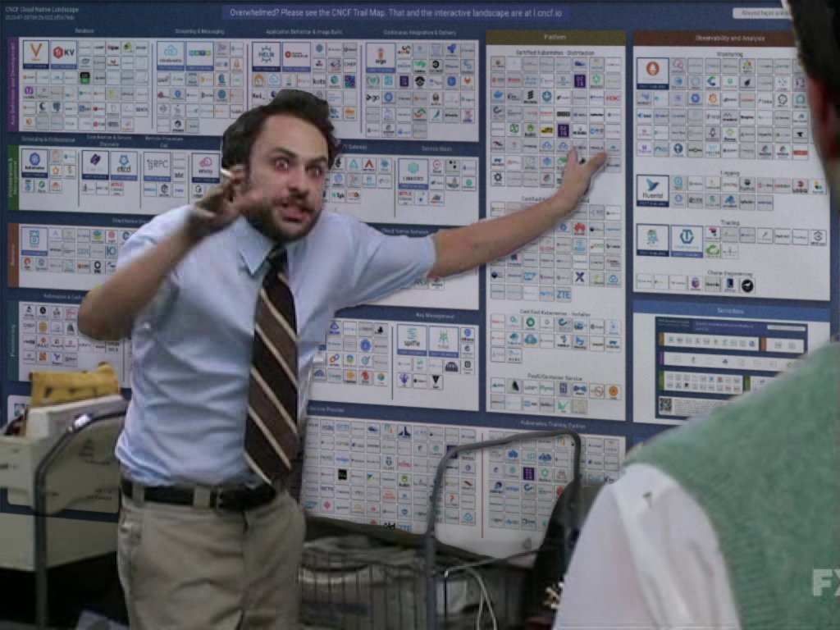
How do I keep up with this stuff?

Slide 32
How do I keep up with this stuff?
Attend as many online events/presentations as you can
SuSEcon
Red Hat Summit
CloudNativeCon
AllDayDevops
and many more...
HackerNews

